Slide 1
The role of surface turbulent fluxes over the ocean in air-sea coupling Past experience and Future perspectives
Alessandro Storer | Supervisor: Hans Mikhail Segura Cajachagua
IMPRS ON EARTH SYSTEM MODELLING
PhD mandate: September 2025 – September 2028

Slide 2

Academic formation and current activity
2019
BSc. in Physics
University of Milan
2022
MSc. in Environmental Meteorology
University of Trento - University of Innsbruck
2024
Junior research assistant
University of Milan Bicocca – sup. Prof. Claudia Pasquero
One proceeding (accepted) and one full article (under rev.)
08.2025
09.2025
PhD candidate
Scale Interaction Modelling group – sup. Dr. Hans Segura

Slide 3
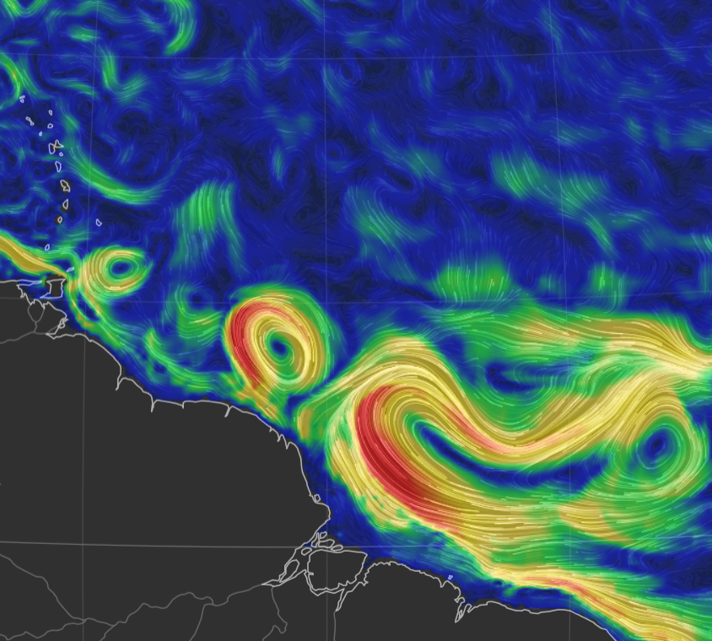

The sub- / mesoscale coupling
Scales < 1000 km are important
in the global energy budget!
(Renault et al. 2023, Seo et al. 2023,
Bishop et al. 2020)
Thermal feedback TFB
Modulates local air temperature, stability and circulation through modified thermodynamic fluxes
(Acquistapace et al. 2022)
How does SST variability act to modulate surface fluxes and hence the air column response?
Sea Sfc. currents on 25° Jan 2020
earth.null.school
How does the importance of SST change with scales?

Slide 4
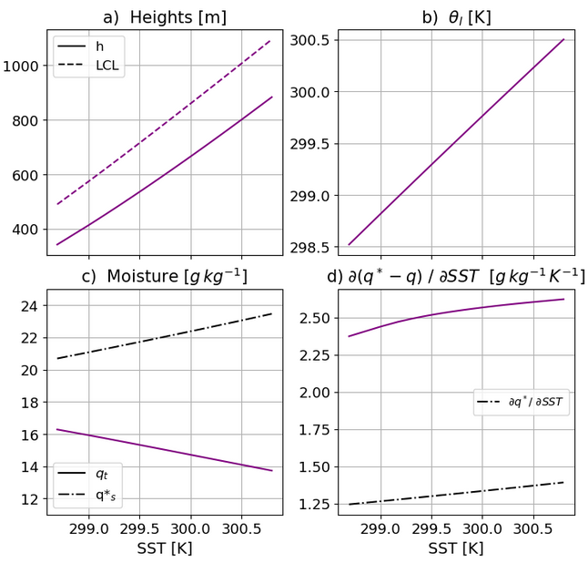
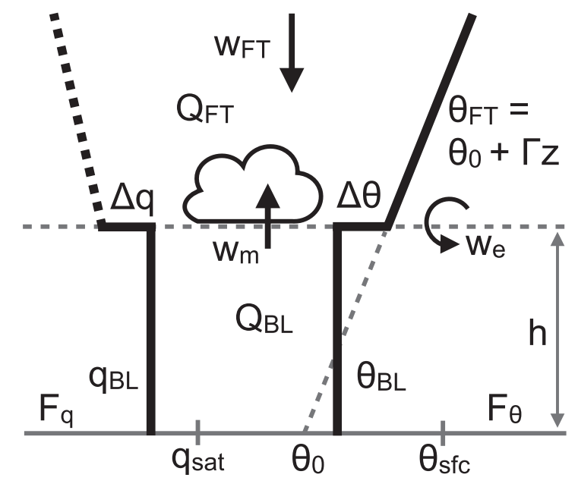
A minimal physics approach
Conceptual Bulk model
starring:
Stevens et al. 2002
Neggers et al. 2006
Naumann et al. 2019

Slide 5
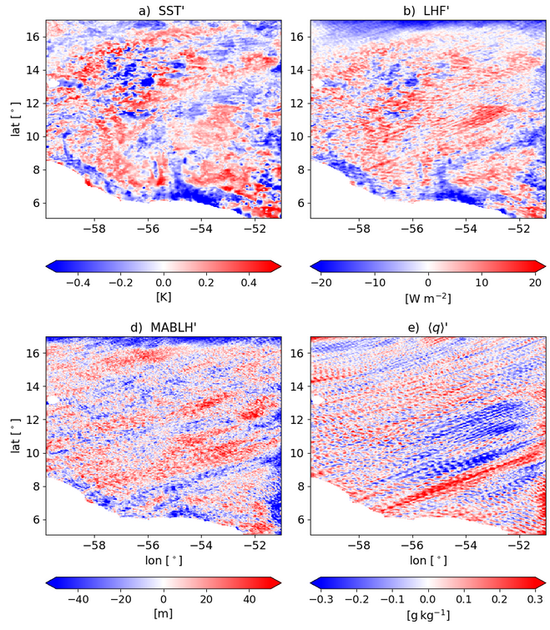
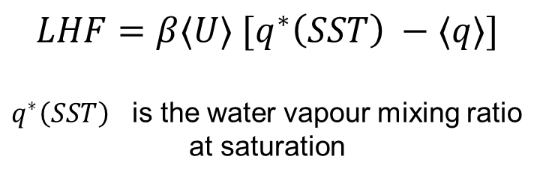
A realistic (complex) set-up
High-resolution WRF simulation:
Gridspace 3km
Daily SST forcing
Daily averages in February 2020
EUREC4A region (Stevens et al. 2021)
$$LHF=β⟨U⟩ [q^{∗}\left(SST\right) −⟨q⟩]$$
$q^{∗}\left(SST\right)$ is the water vapour mixing ratio at saturation

Slide 6
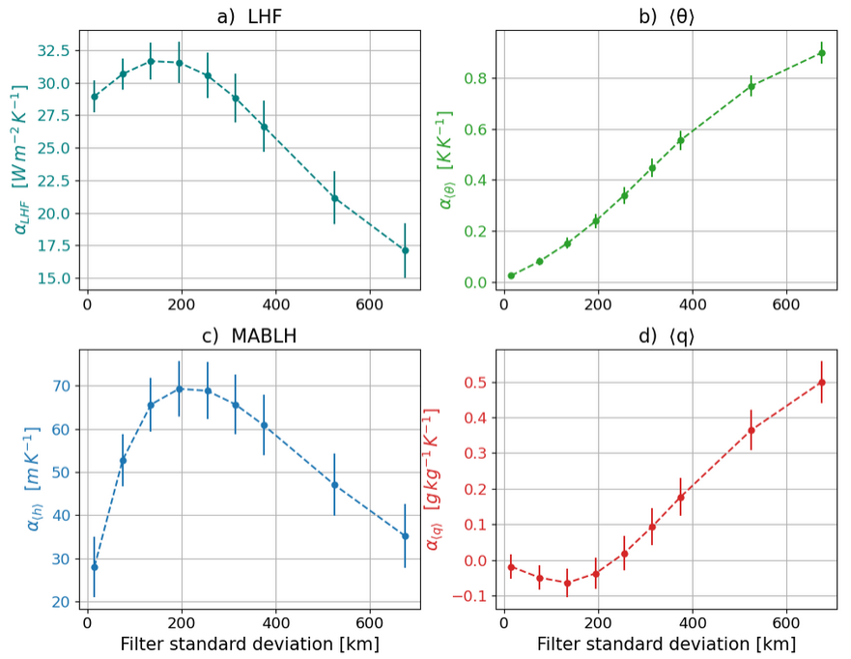
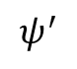
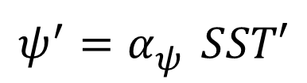
Scale-dependent coupling
$$ψ^{′}=α_{ψ}^{} SST′$$
$$ψ^{′}$$
SST’

Slide 7
Now, with this acquired knowledge…

Slide 8
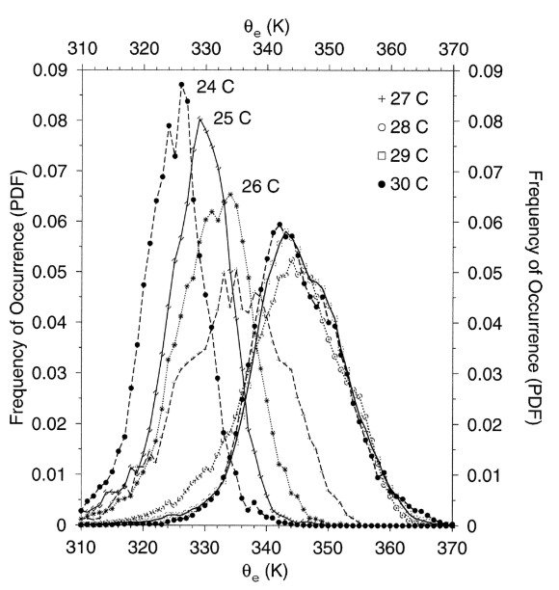
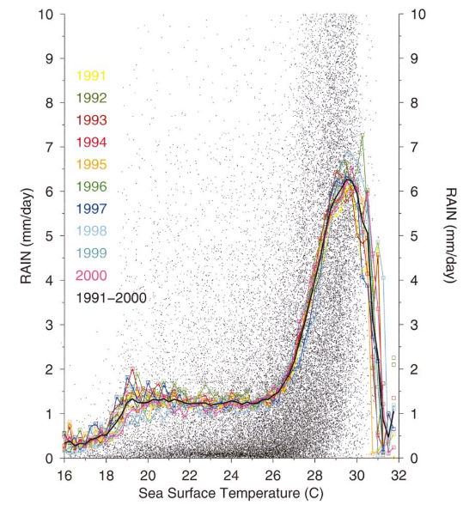
tropical precipitation…
Ian and Braun, 2002

Slide 9

…And Boundary layer quasi-equilibrium
Conditions typical for the Warm Pool region
i.e. light winds , low SST gradients
MABL
$$\dot{MSE}≈SHF+LHF$$
SHF
LHF
The warm sea of the Warm Pool
MSE
Notes:
Free-tropospheric MSE is constant along pseudo-adiabats

Slide 10

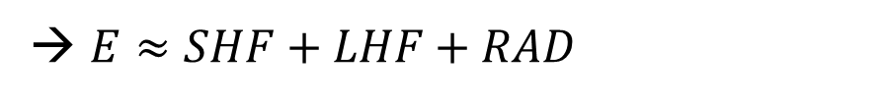
What to do? – Initial numerical study
Suitable definition of boundary layer → there are many!
MSE budget analysis over longer-than-convective timescales
→ $E≈SHF+LHF+RAD$
Assess the full time-dependent evolution of MSE to characterize:
Modified MSE budget in precipitating and non-precipitating regions → when and where is convection exactly triggered?
Role of downdrafts and, hence, the interaction of different scales of variability

Slide 11
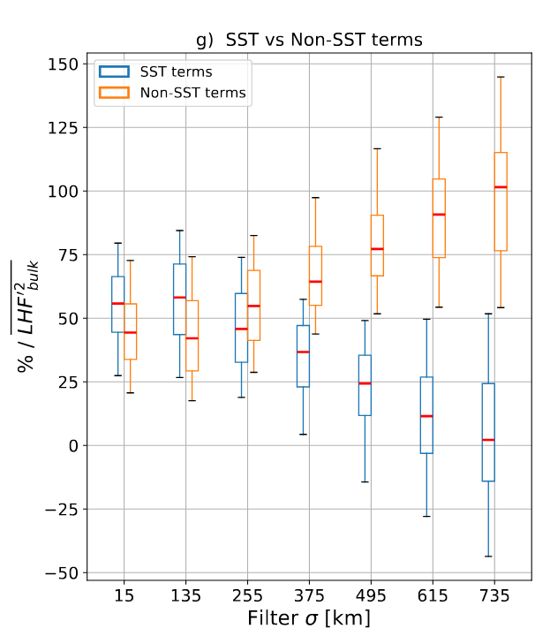
Spatial variability of lhf exchange
Now, with this acquired knowledge ….

Slide 13
Notes:
Check how WRF is computing surface fluxes in the coupled simulation

Slide 14
Boundary Layer
T , q air
wind
SST, q source
Turbulent fluxes
LHF, SHF
currents
Notes:
the coupling between marine shallow
trade-wind clouds and circulation is known to play a cen-
tral role in the uncertainty of the tropical cloud feedback and climate sensitivity estimated by models

Slide 15
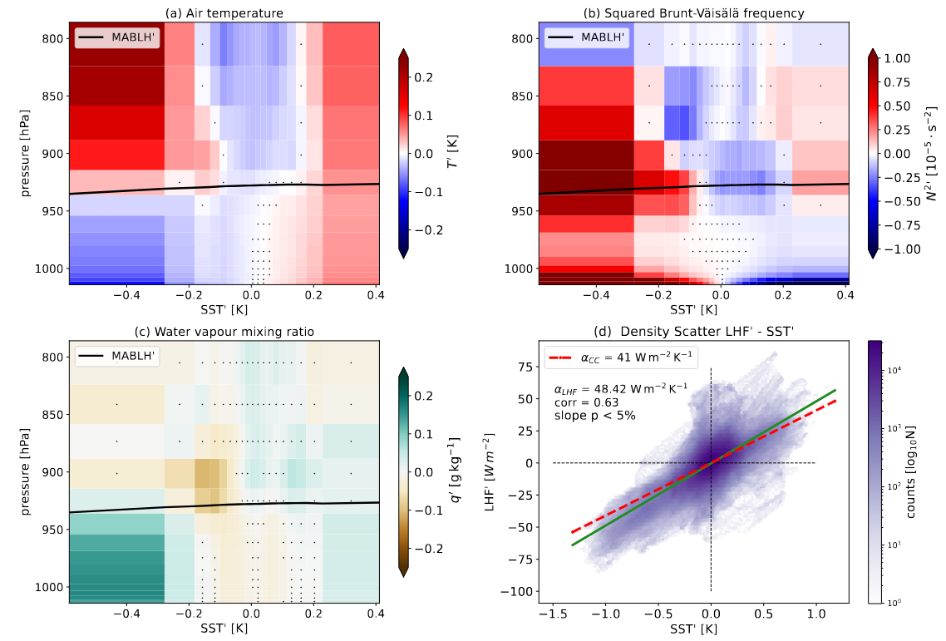
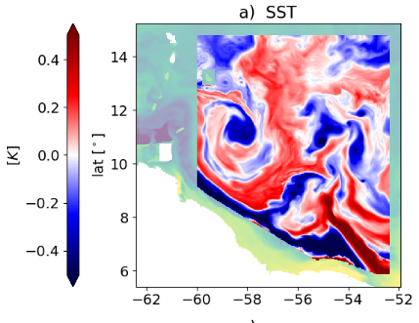

Vertical MABL response in a coupled simulation
a) Fully-coupled simulation
Fixed scale of interest < ~150km
→ correlate SST’ with atmosphere

Slide 16
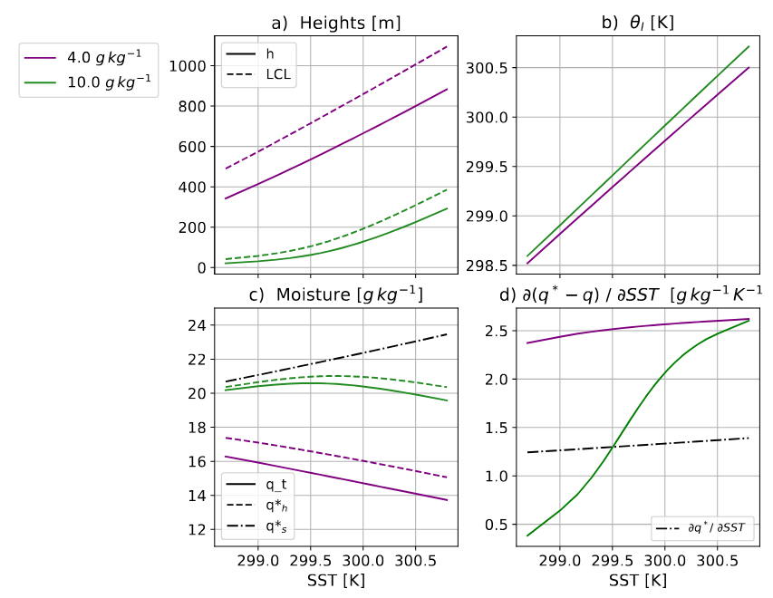
Two conceptual scenarios

Slide 17
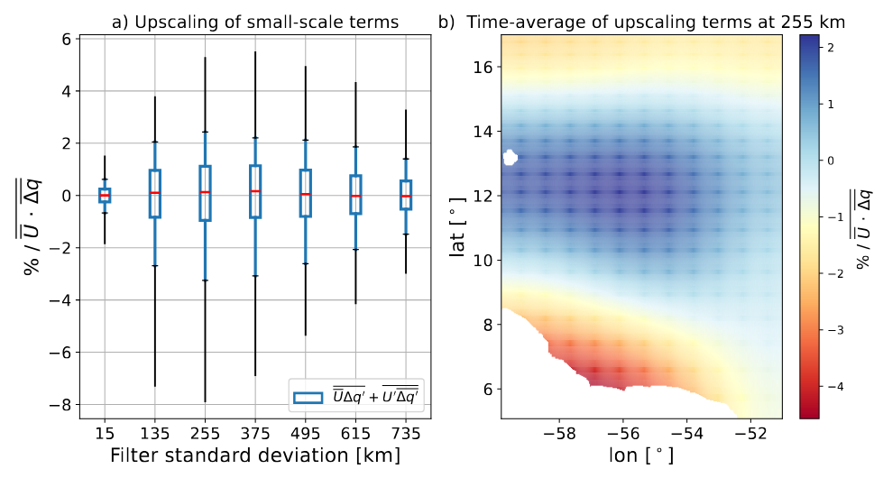
Upscaling effect in LHF modulation

Slide 18
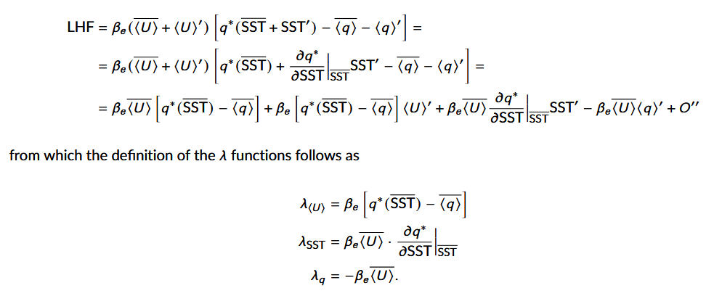
Backup

Slide 19

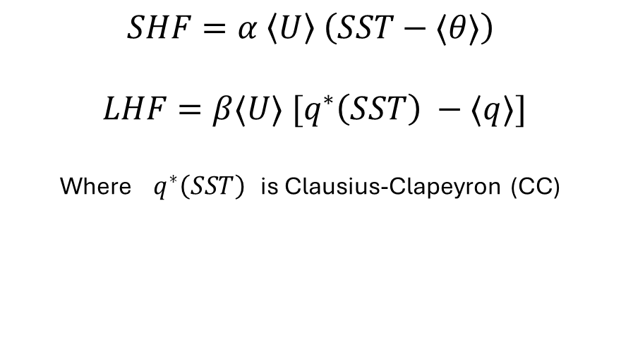
Sensitivity of surface fluxes to SST
MABL
$$SHF=α \left\langle U\right\rangle \left(SST−⟨θ⟩\right)$$
$$LHF=β⟨U⟩ [q^{∗}\left(SST\right) −⟨q⟩]$$
Where $q^{∗}\left(SST\right)$ is Clausius-Clapeyron (CC)
SHF’ ?
LHF’ ?
SHF’ ?
LHF’ ?
$$sensitivities == \frac{∂HF′}{∂SST′}$$
SST’ < 0
SST’ > 0
Notes:
Check how WRF is computing surface fluxes in the coupled simulation

Slide 20



A minimal physics approach
What is the range of validity of this 1D bulk model ?
How does the thermodynamic adjustment change with scales?

Slide 21
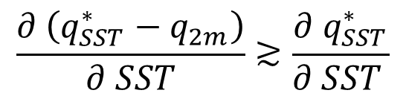
Conclusions
MABL – SST coupling is scale-dependent
Primary mechanism for
thermodynamic adjustment
over daily means
MABLH’
Feedback on surface LHF
$$\frac{∂ \left(q_{SST}^{∗}−q_{2m}\right)}{∂ SST}≳\frac{∂{ q}_{SST}^{∗}}{∂ SST }$$
Small-scale SST variability
dominates LHF variance
and excites non-linear upscaling effects
SST’ < 0
SST’ > 0

